Slide 1
Harmony Heroes 5 ways to wellbeing
This presentation was made by Abigail, Jac, Eden, Louie. Today we are going to share the 5 ways to wellbeing.

Slide 2
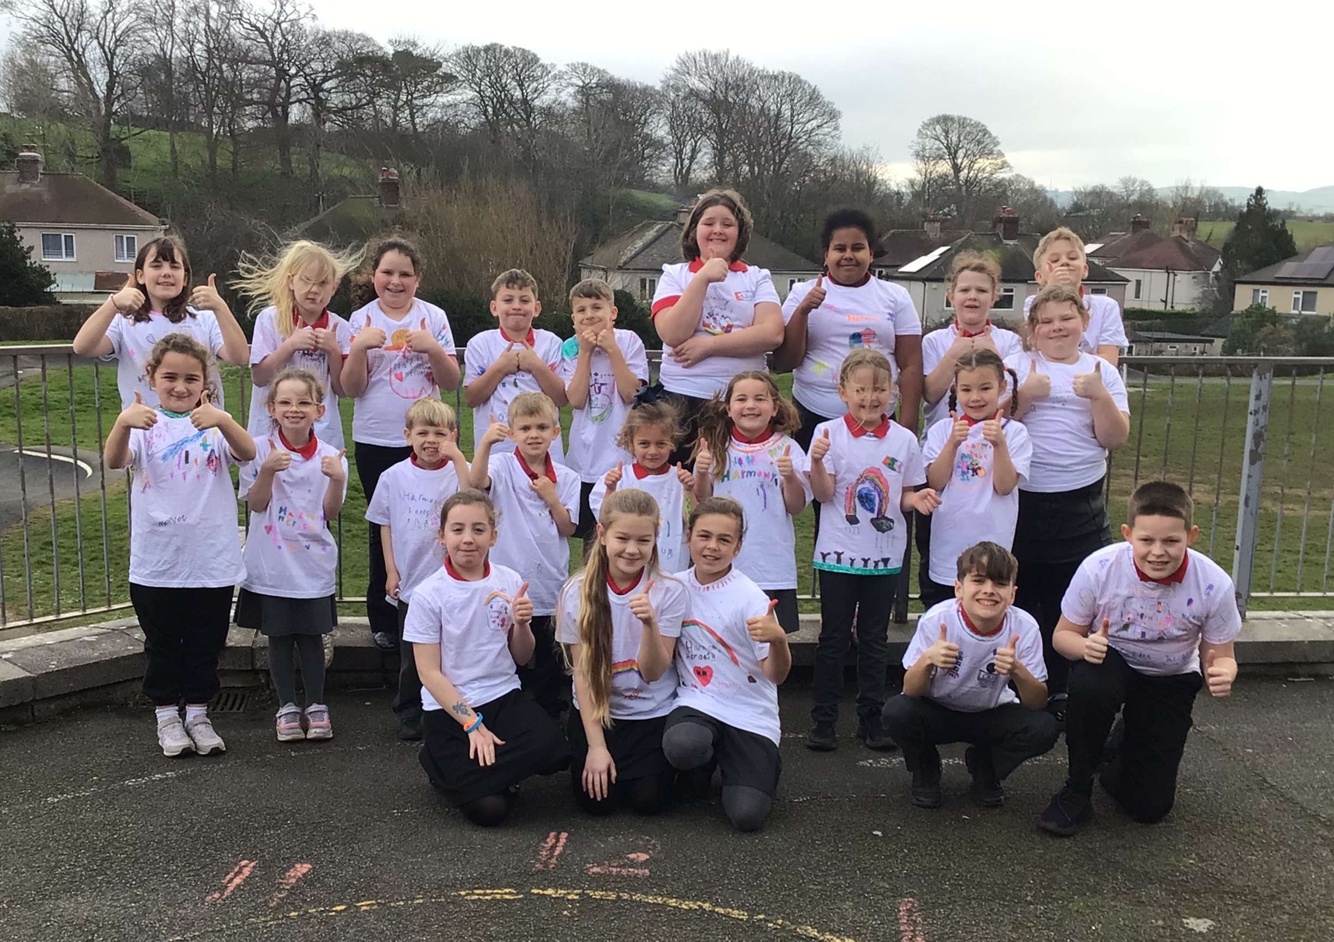
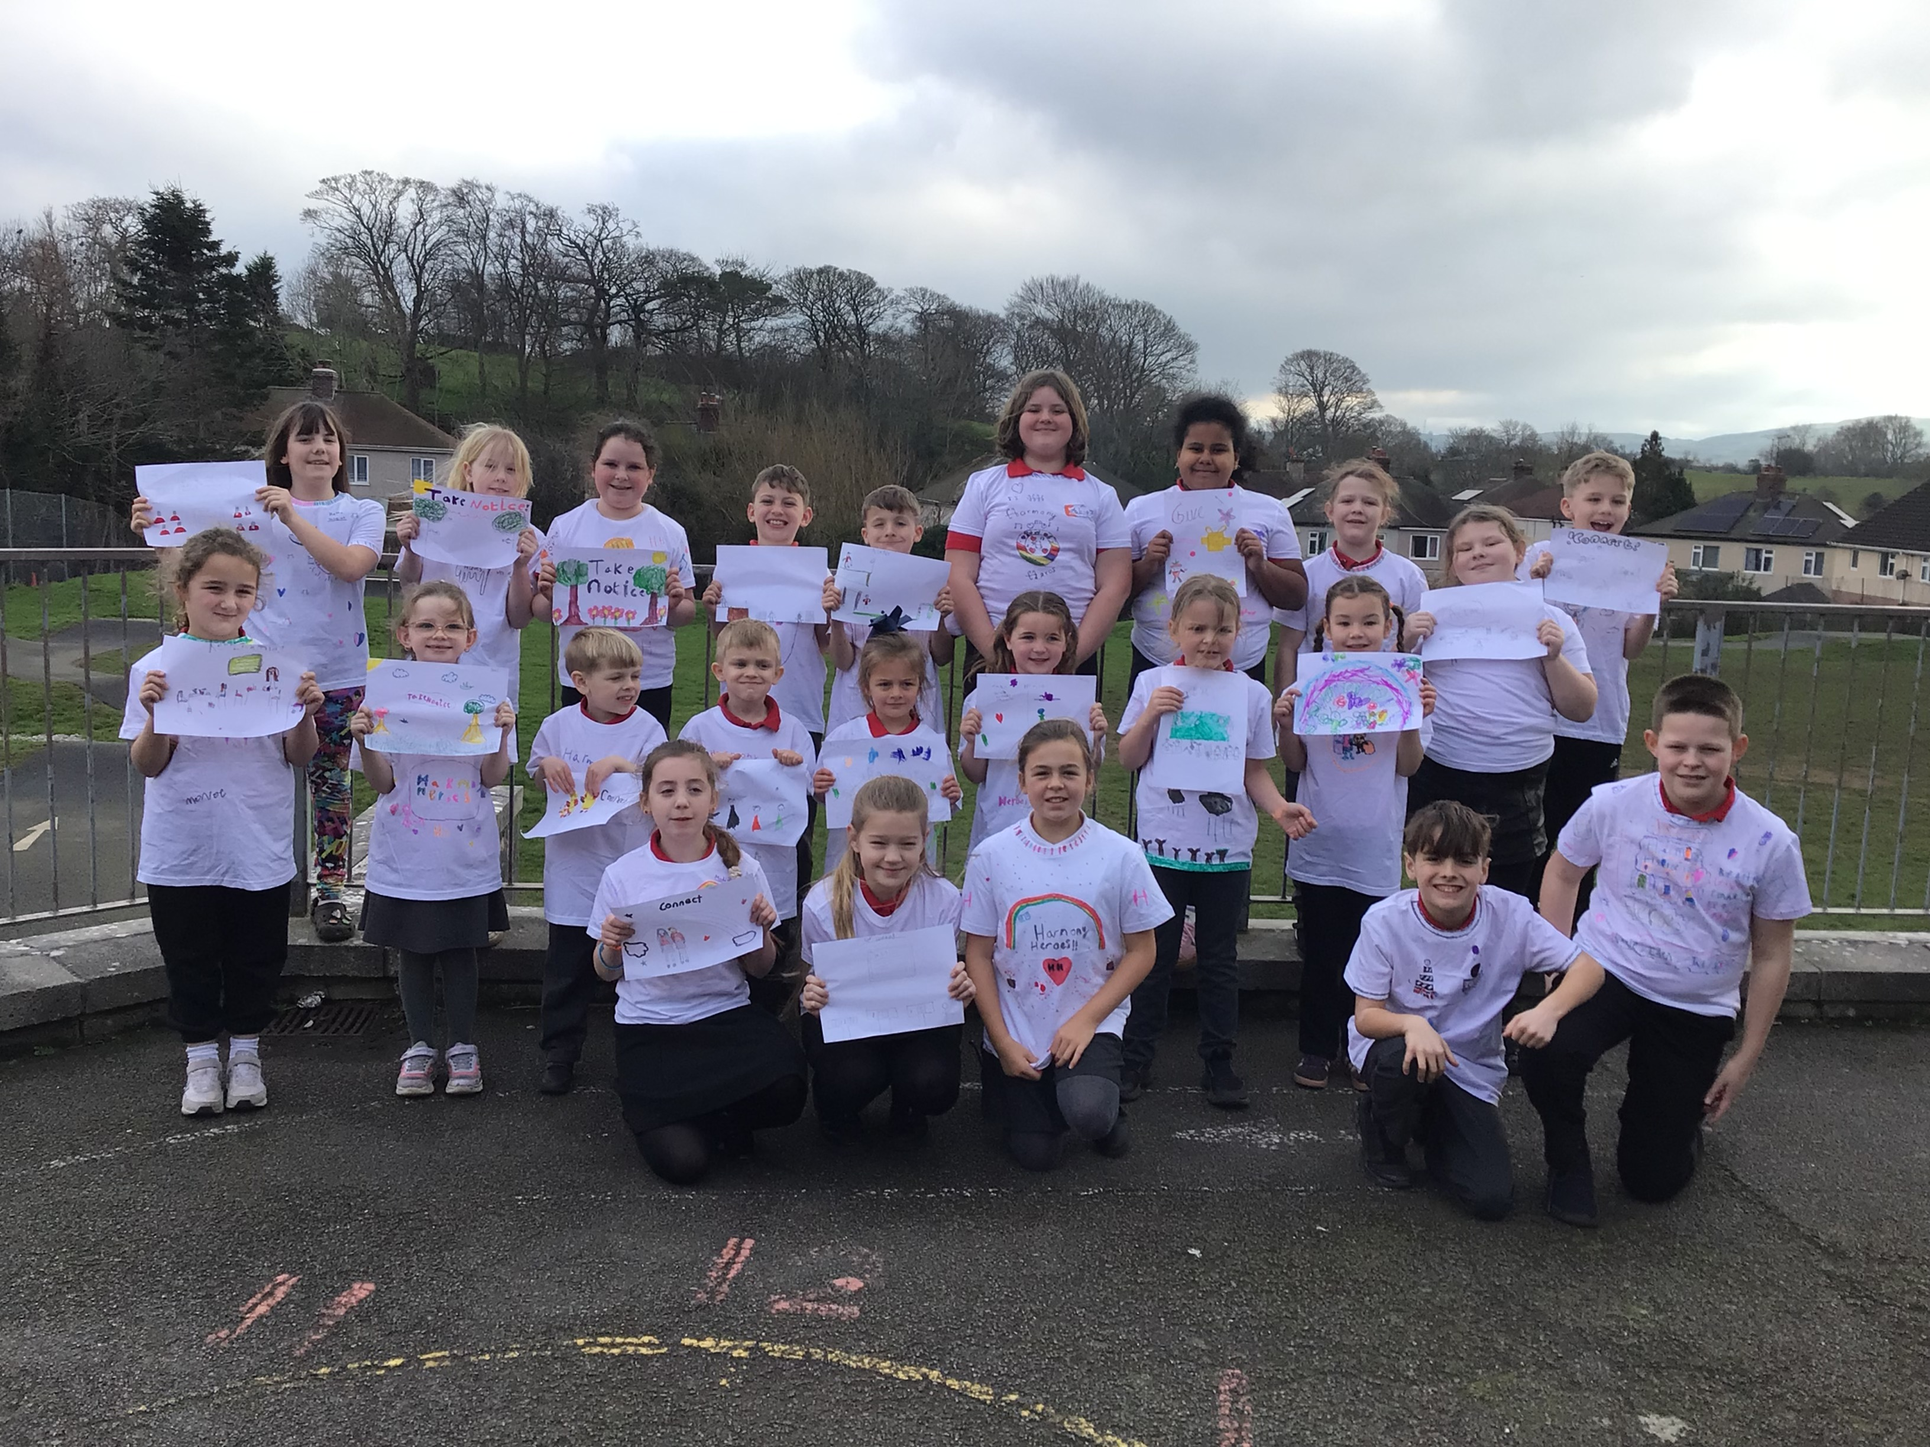

Harmony heroes-here we are in the t-shirts we made.

Slide 3
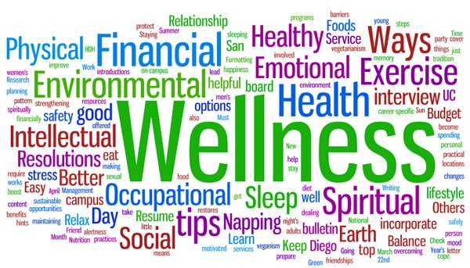
5 WAYS TO WELLBIENG
CONNECT GIVE BE ACTIVE KEEP LEARNING

Slide 4

Connect
Connect means spending time with your family and friends and being together. And joining new clubs and meeting new people.

Slide 5
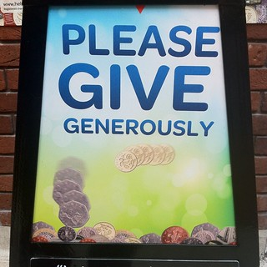
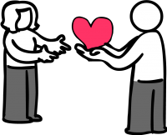
Give
Give is one of the ways to wellbeing. Give is a way to get friends and to be kind.

Slide 6

Be Active
Be Active means to stay active and keep your body moving by working out drinking water and going for runs, bike rides scootering, walks and playing sports.

Slide 7
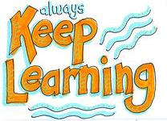
Keep learning
Learn a New Skill or Hobby: Try cooking a new recipe, learning to play a musical instrument, or repairing something around the house.
Engage with Education: Sign up for a course, learn a new language, or visit a museum to explore history.

Slide 8
Take notice
Notice the world
Slow down
Try...
Deep Breathing: Inhale deeply through your nose, allowing your abdomen to expand, then exhale slowly through your mouth to activate the body’s relaxation response.
Physical Release: If you feel tense, try shaking your hands, stretching, or taking a quick walk to release pent-up energy

Slide 9
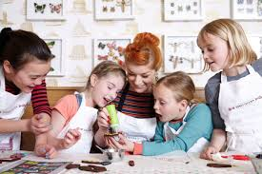
Why we invited you today?
Is helps us to talk, laugh, and spend time together
We wanted to connect with you by doing something together

Slide 10
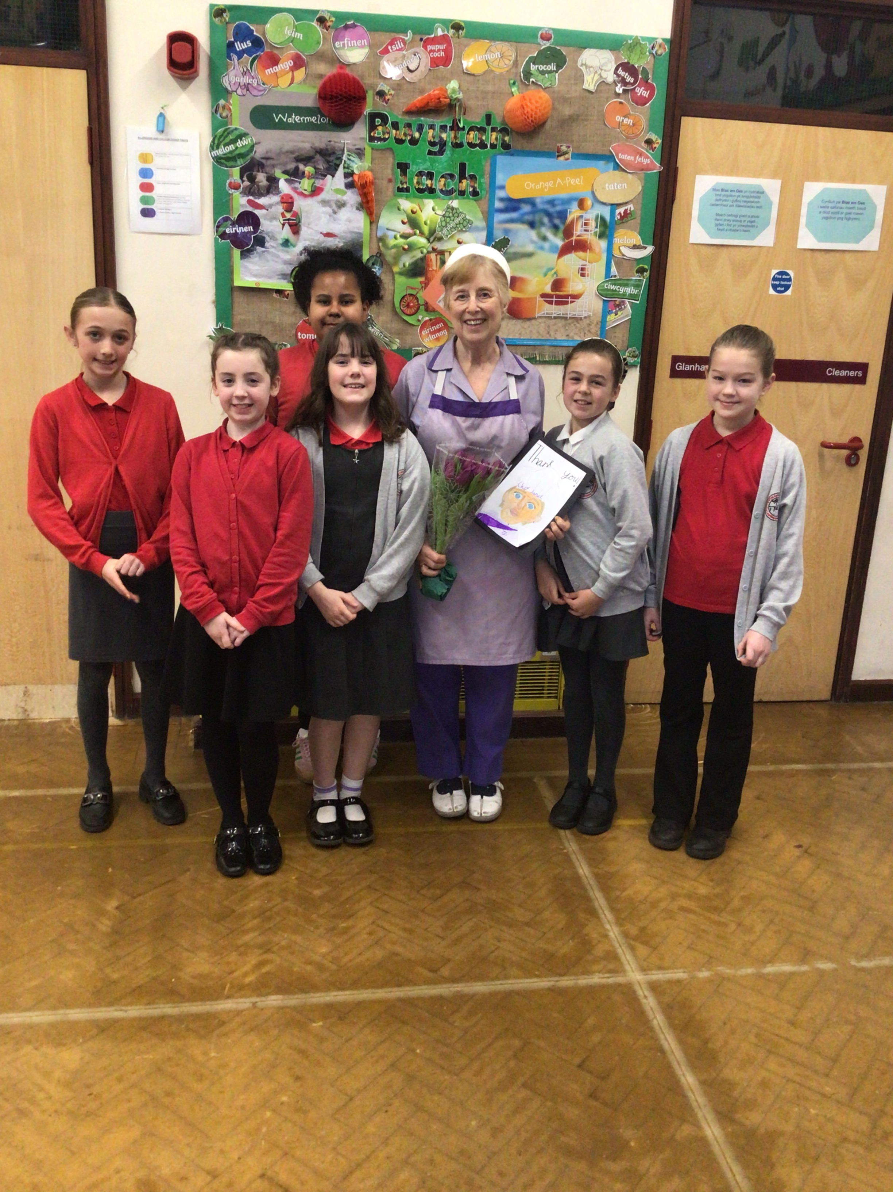
Lets get started...
Now we'd like you to decorate a biscuit with us, please could you just decorate one biscuit between you to make sure we have enough decorations Thank you.
While we do it, we can chat and enjoy spending time together.
Thank you for being Harmony Heroes with us.
We have a table full of games help yourself as we know how important this can be to connect.
And a big thank you to chef Janet for making the biscuits.

