Slide 1
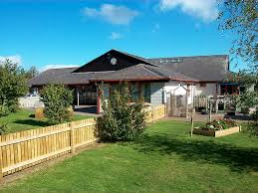
Ysgol Cynfran – Newsletter
Friday 15th September 2023
News from the Deputy Headteacher
We've had another busy week. The children are all settling into their new routines and there are lots of happy smiling faces around the school every day.
We had visitors from the Conwy Music Service in school on Wednesday who gave us a wonderful performance playing drums and the guitar. More details on lessons will follow.
Cycle training will start for Dosbarth Marian and Dosbarth Elian next Monday. Dosbarth Marian (Mrs Hughes' class) have had permission forms to sign. Please follow the link sent by Mrs Gregory. Other classes will start using the track in the coming weeks. Can both classes bring bikes to school if possible please.
We all enjoyed Roald Dahl day on Wednesday. Each class took part in activities based around books written by Roald Dahl. We had lots of children dressed as Matilda, Willy Wonka and many other Roald Dahl characters. Dosbarth Elian was even taught by one of the witches!
Thank you to Mrs Yates and Mrs Heap who organised the whole school making sure everyone had a picture taken on Monday. They did a marvellous job!
As we settle back into the routine of making packed lunches and getting the children to school, please remember we are a NUT FREE SCHOOL. We thank you for helping us with this.
One Page Profile sheets have been sent home this week. Please complete this as best as you can to help us to help them and of course you. Diolch.
Have a lovely weekend,
Beth Hughes
Important Dates 2023
Monday 18th September – cycle training
Thursday 21st September- MW Sports Dosbarth Y Llan to Dosbarth Elian
Tuesday 26th September
European Day of Languages
October 2nd & 3rd
Designed to Smile visit Dosbarth Dulas to Dobarth Betws
____________________
Family Worker – Ceri
ALL WELCOME
Friday 13th October – 9am
Friday 10th November – 9am
Friday 8th December – 9am
____________________
Staff Training Days
January 8
April 8
July 18 & 19
Dolwen Road,
Llysfaen, LL29 8SS
01492 517326
www.ysgolcynfran.co.uk
pennaeth@cynfran.conwy.sch.uk
Class News
Dosbarth Dulas – have enjoyed celebrating the author Roald Dahl, we have looked at The BFG - decorated dream jars, made dream catchers and created our own BFG.
Dosbarth Y Llan – enjoyed learning about Roald Dahl this week
Dosbarth Betws – enjoyed dressing up and celebrating Roald Dahl Day.
Dosbarth Dolwen – has enjoyed Roald Dahl Day, and they especially enjoyed a visit from Conwy musicians.
Dosbarth Marian – enjoyed learning about children working in Victorian times.
Dosbarth Elian - completed their future me letters and pictures. They have brought them home to open in 20 years time. They also began their new mantle on the Deep Mine. They started to look at jobs children did in mines.

Slide 2
Notice Board
Seren Yr Wythnos
Dosbarth Dulas: G Jones &
M Hackett-Evans
Dosbarth Y Llan: B Hamlet-Jolley
Dosbarth Betws: M Walker
Dosbarth Dolwen: L Stevens
Dosbarth Marian: M Mellor
Dosbarth Elian: R Neild
Birthday Celebrations
I Hills (Dulas)
P Jones (Dolwen)
C Jones (Elian)
P-P Hughes (Dulas)
Cymro/Cymraes Yr Wythnos
Dosbarth Dulas: S Vaughan
& C Moreland
Dosbarth Y Llan: All of DYL
Dosbarth Betws: A Ayres
Dosbarth Dolwen: E Dawson-Parry
Dosbarth Marian: K Tuck
Dosbarth Elian: D Hughes
Wales Senior Women will face USA at Stadiwm CSM (Eirias Park, Colwyn Bay) on Saturday 30 September. Tickets are £5 for adults and £1 for children.
Remember
We are a cash less school – payment for breakfast club, trips etc. can be paid via parentpay or paypoint
REMINDER
Please ring school
as early as possible
if your child is going
to be absent
Safeguarding
Our Designated Safeguarding Officers
are Mr Owen Rogers and Mrs Beth
Hughes. If you need to talk to us
about any concerns, please contact
us at School.

Slide 3
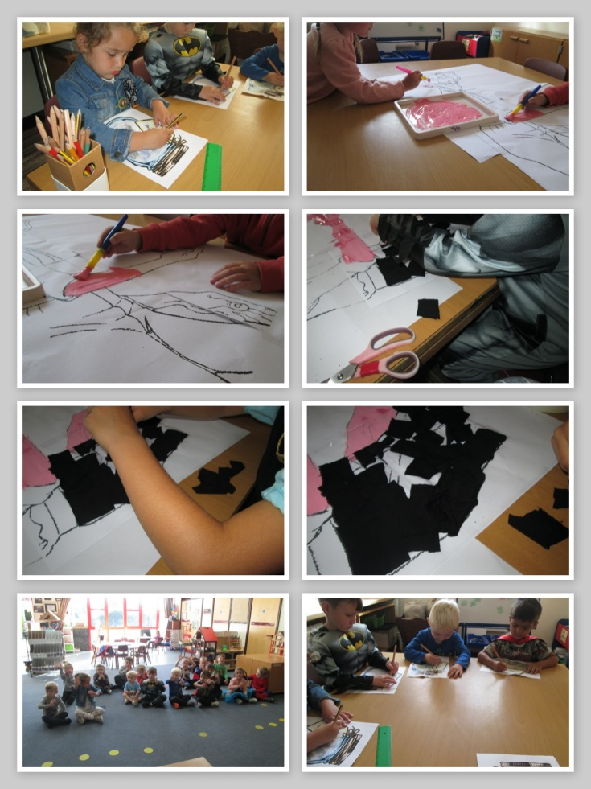
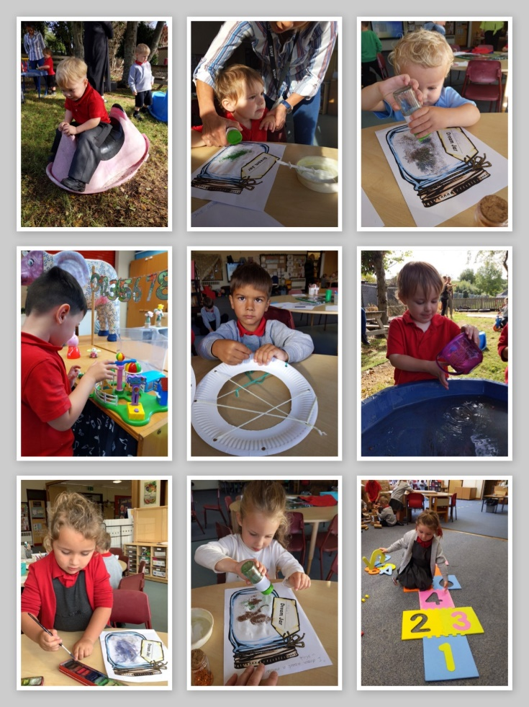
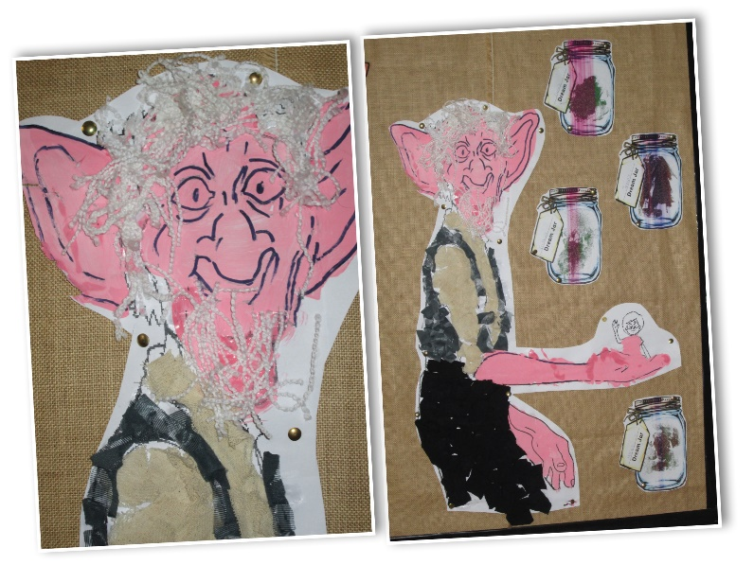
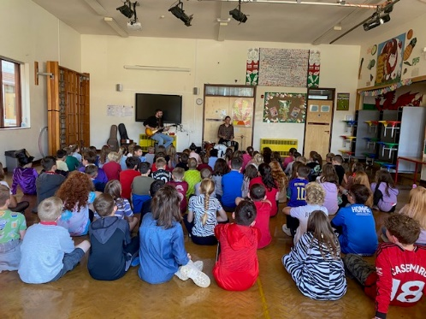
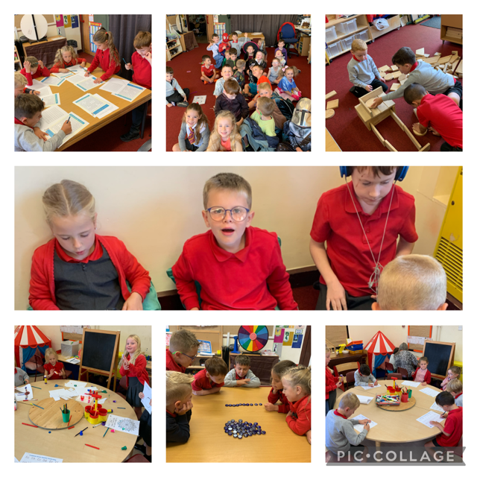
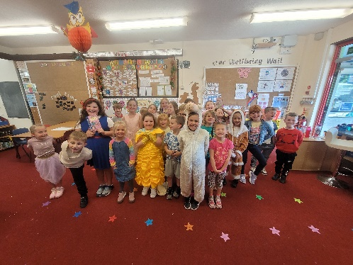
Our week in pictures …

Slide 4
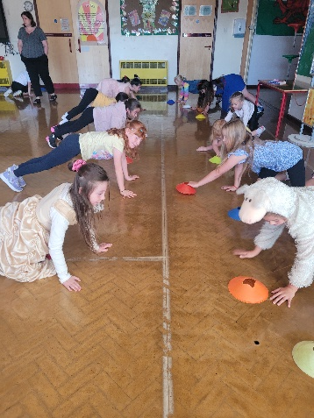
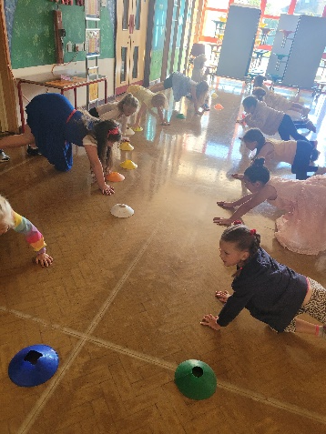
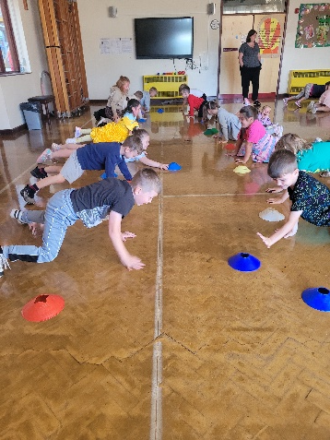
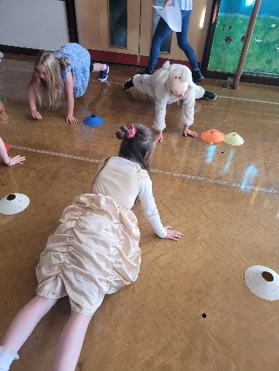
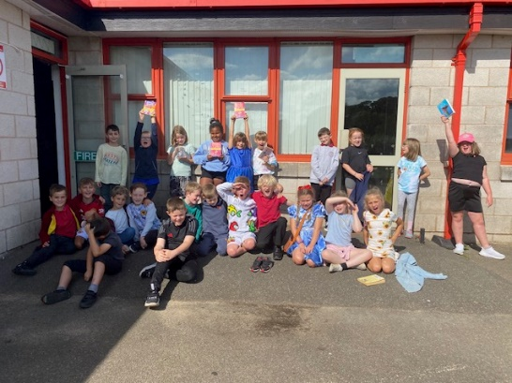
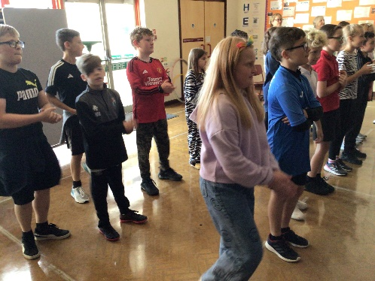
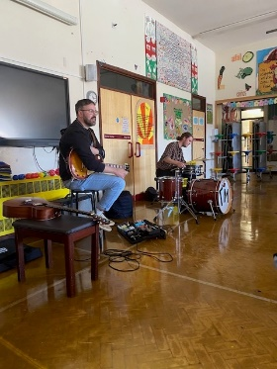
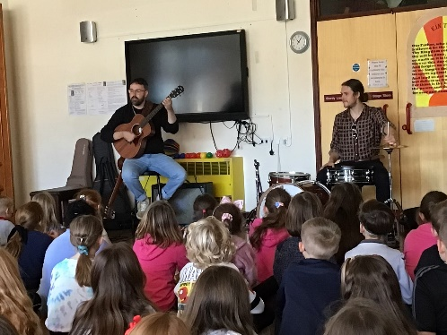
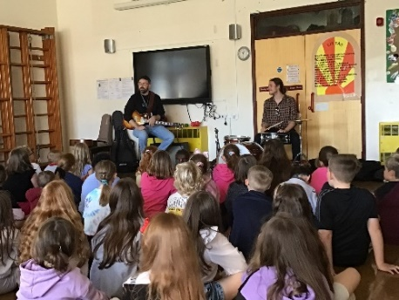
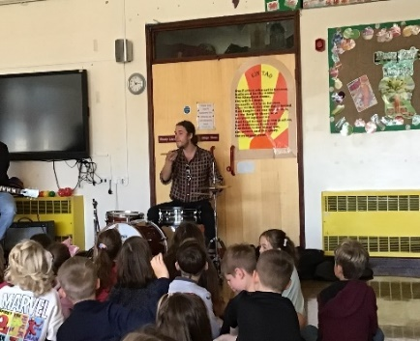
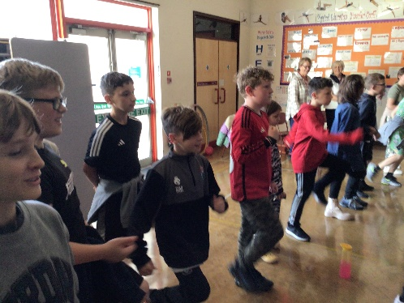
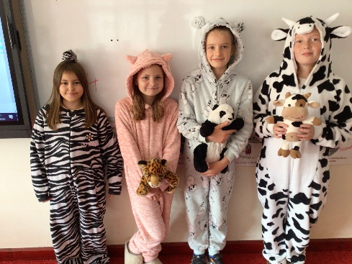
Our week in pictures …

