Slide 1
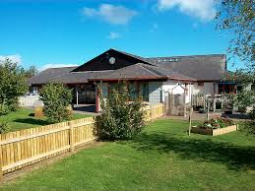
Ysgol Cynfran – Newsletter
Friday 29th September 2023
News from the Deputy Head
The weather was kinder to us this week, so we started off with some great track training on the cycle track. Next Monday is Dosbarth Marian and Dosbarth Betws' turn. The following Monday it will be Dosbarth Y Llan and Dosbarth Dulas' turn. Dosbarth Elian's session has been rearranged for the 16th of October. Mr Emberton is working hard on a rota for the track, so we will be having regular cycle lessons as part of our Health and Wellbeing lessons very soon.
Thank you to everyone who is sending their children to school in their PE kits on the relevant days. It helps us to ensure that the children have a full and active lesson.
On Tuesday, we celebrated the European day of languages. The children had fun learning about the culture, language and traditions of various European countries. Dosbarth Dulas celebrated Holland, Dosbarth Y Llan celebrated Sweden, Dosbarth Betws learned about Spain, Dosbarth Dolwen learned some French words, Dosbarth Marian had a great time learning about Germany and Dosbarth Elian enjoyed learning about Greece. Thank you to the staff for organising such a lovely day.
Chef Janet helped us to celebrate European day with a European twist to the menu this week. We had Swedish meatballs and Italian spaghetti bolognaise during the week. She has also been creating some lovely desserts with apples such as yummy apple cake and custard. There were lots of very clean plates this week. Thank you, Chef Janet.
We held our School Council and Eco Council elections this week. The elected representatives from each class will be busy helping us with various activities very soon.
Thank you all for your continuing support, I hope you all have a lovely weekend.
Kind regards,
Beth Hughes
Important Dates 2023
October 2nd & 3rd
Designed to Smile visit Dosbarth Dulas to Dobarth Betws
Thursday 5th October - MW Sports Dosbarth Y Llan to Dosbarth Elian – 3.00-4.15pm
Tuesday 10th October
Bryn Elian Open Evening for Dosbarth Elian pupils – 5.30-7.30
________________________
Pop In For A Panad (mobile classroom – All welcome)
Tuesday 10th October 2.30-3.00
Tuesday 28th November 2.30-3.00
________________________
Family Worker – Ceri
ALL WELCOME
Friday 13th October – 9am
Friday 10th November – 9am
Friday 8th December – 9am
________________________
October Half Term
School closes – Friday 27th October
School reopens – Monday 6th November
Staff Training Days 2024
January 8
April 8
July 18 & 19
Dolwen Road,
Llysfaen, LL29 8SS
01492 517326
www.ysgolcynfran.co.uk
pennaeth@cynfran.conwy.sch.uk
Class News
Dosbarth Dulas: have enjoyed learning about Holland. We have designed clogs, painted tulips, tasted traditional Dutch food and made windmills using recycled materials.
Dosbarth Y Llan: we made fruit kebabs as part of our food topic and Dala horses in celebration of Sweden.
Dosbarth Betws: enjoyed learning about Spanish culture and traditions.
Dosbarth Dolwen: have enjoyed the cycle track and European Day this week.
Dosbarth Marian: enjoyed celebrating European Day of Languages on Tuesday. We have also been learning about schools in the Victorian times and used natural resources to create our own writing materials.
Dosbarth Elian: we enjoyed learning about Greece and creating our own gods and goddesses. We also met a trapper in the mines and painted him. We worked out how much money he would have been paid.

Slide 2
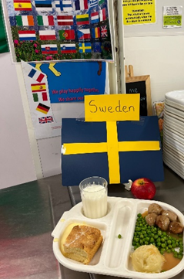
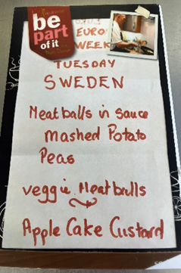
Notice Board
Seren Yr Wythnos
Dosbarth Dulas: Paisley-Primrose H / Robin H
Dosbarth Y Llan: Nancy D-P
Dosbarth Betws: Willow H
Dosbarth Dolwen: Abigail C
Dosbarth Marian: Oakley H
Dosbarth Elian: Riley E
Cymro/Cymraes Yr Wythnos
Dosbarth Dulas: Cali M / William McI
Dosbarth Y Llan: All of the class
Dosbarth Betws: Khloe J
Dosbarth Dolwen: Joshua H
Dosbarth Marian: Kayla T
Dosbarth Elian: Samuel O
Birthday Celebrations
Tyler W (Elian)
Daisy E (Elian)
REMINDER
Please ring school as early as possible if your child is going to be absent
Remember
We are a cash less school – payment for breakfast club, trips etc. can be paid via parentpay or paypoint
Welsh National Opera is bringing “Play Opera Live Space Spectacular” to Venue Cymru – 14th October 2023, 3:30 pm. Running time approximately one hour and 10 minutes with no interval
Adult £15
Child £7.50
More information: Play Opera Live (Autumn) | Venue Cymru
Safeguarding
Our Designated Safeguarding Officers
are Mr Owen Rogers, Mrs Beth Hughes
& Mrs Cora Williams. If you need to talk
to us about any concerns, please contact
us at School.

Slide 3
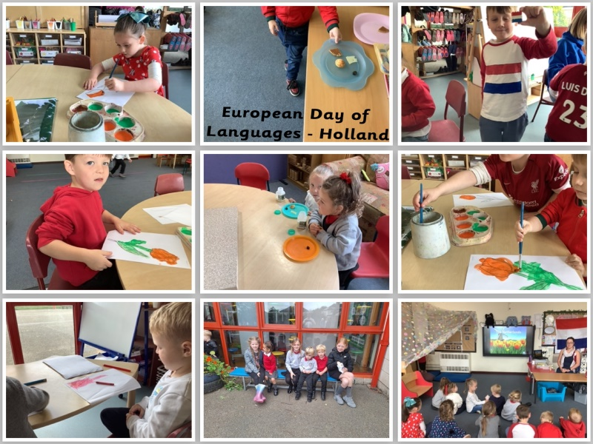
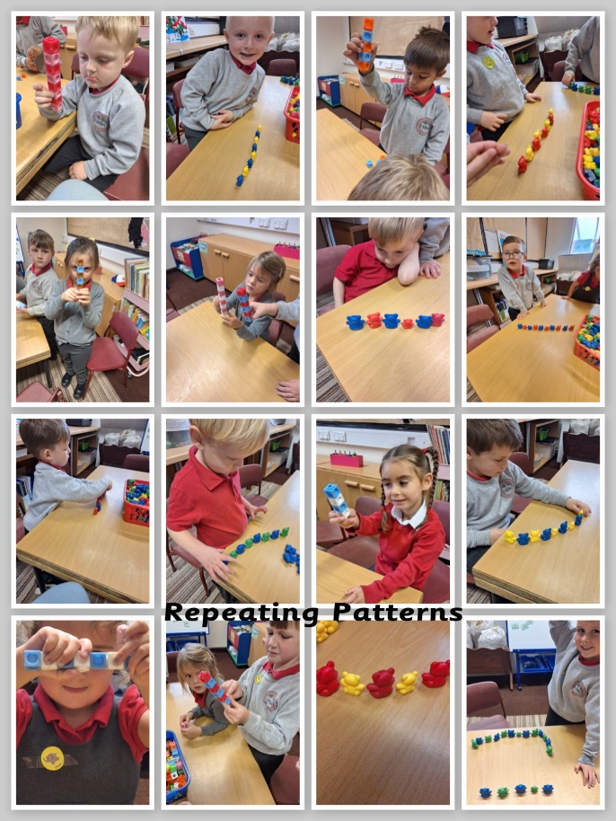
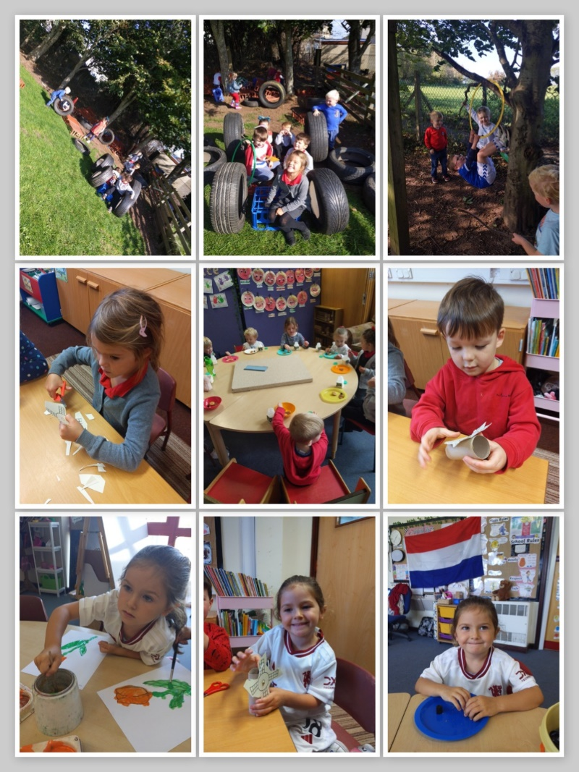
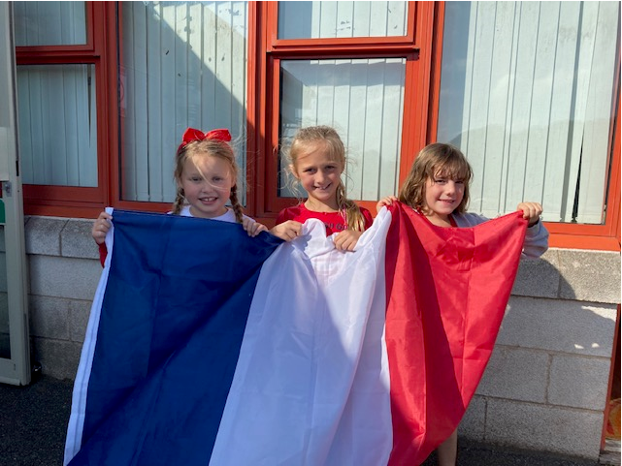
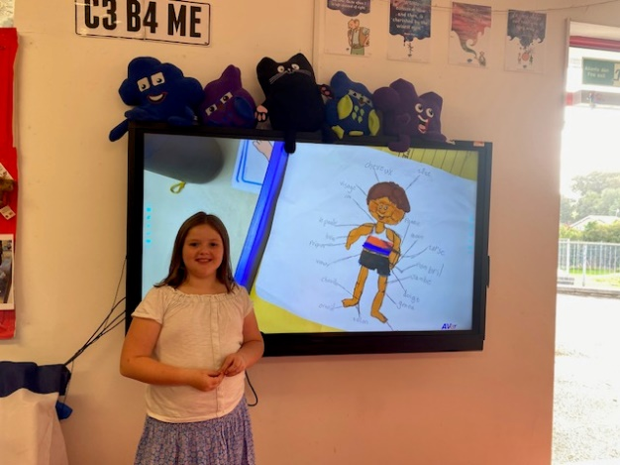
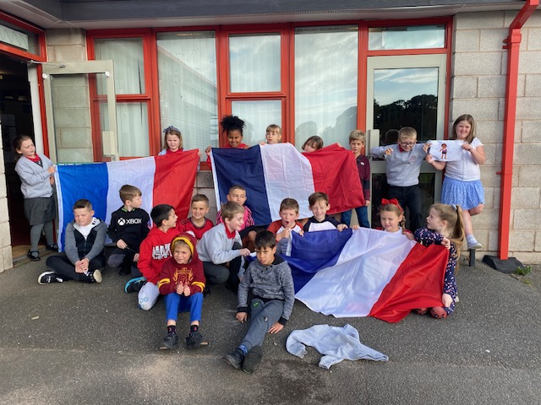
Our week in pictures …

Slide 4
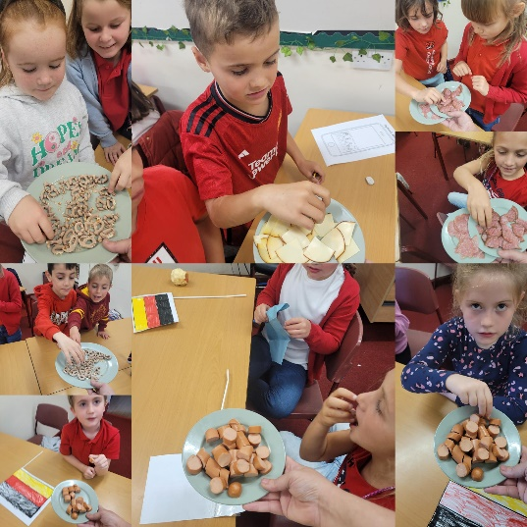
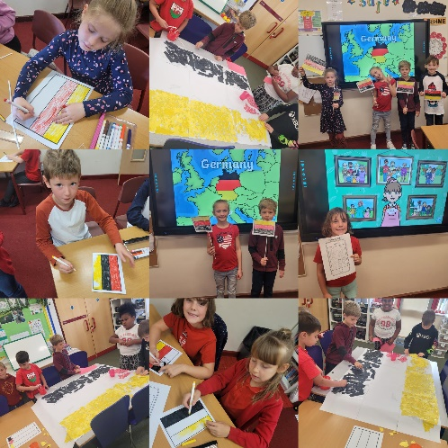
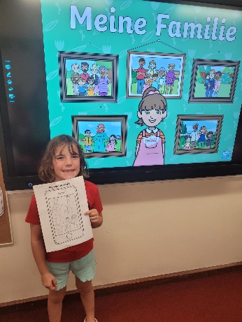
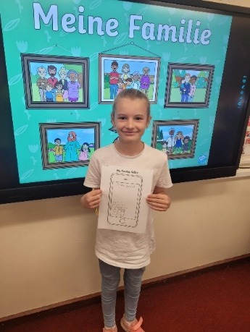
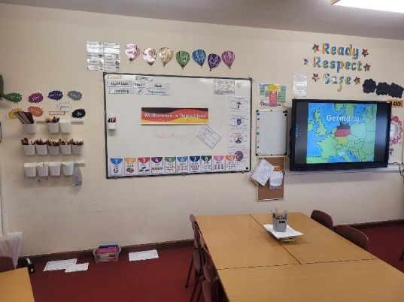
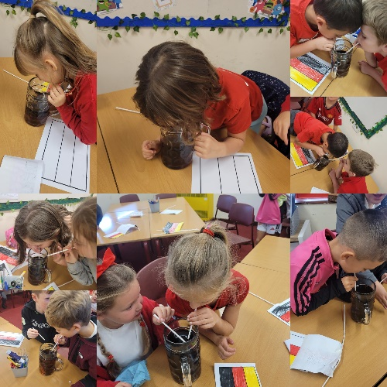
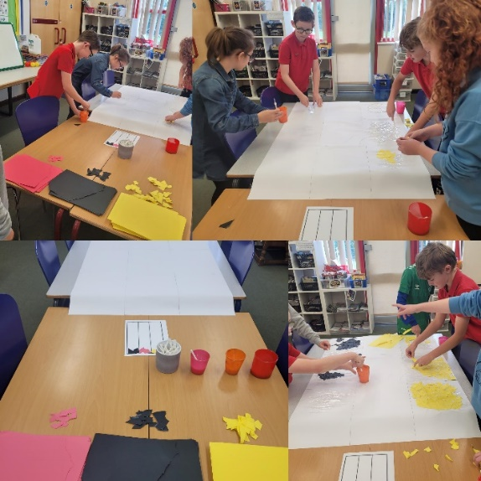
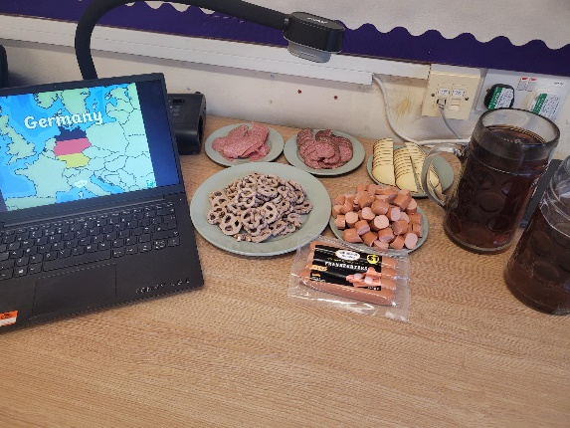
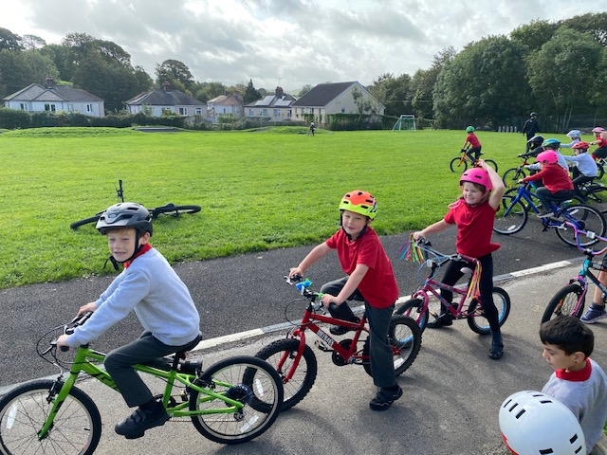
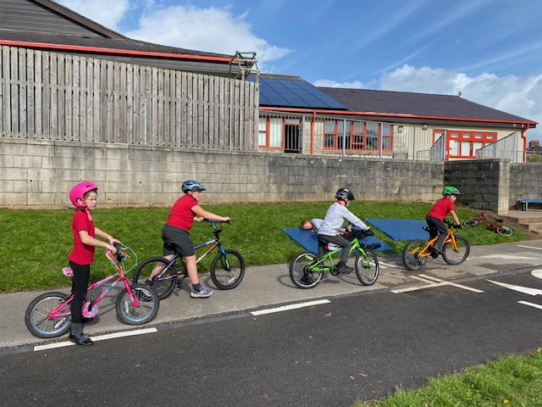
Our week in pictures …

Slide 5
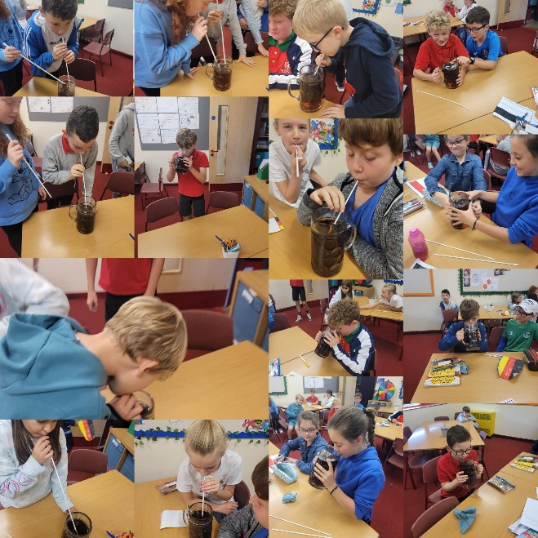
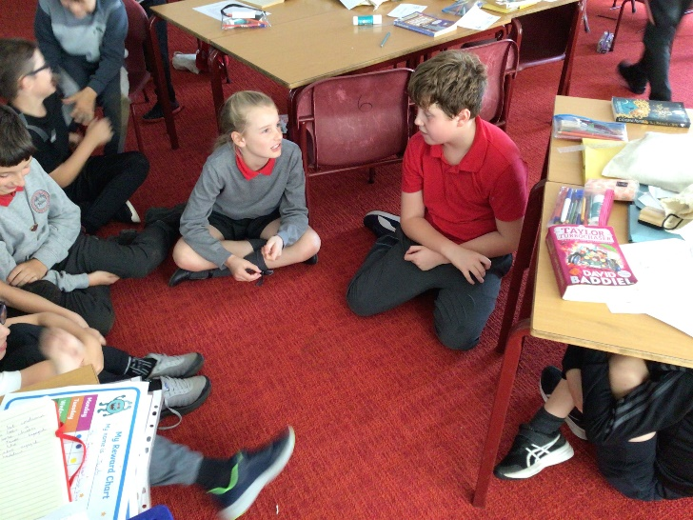
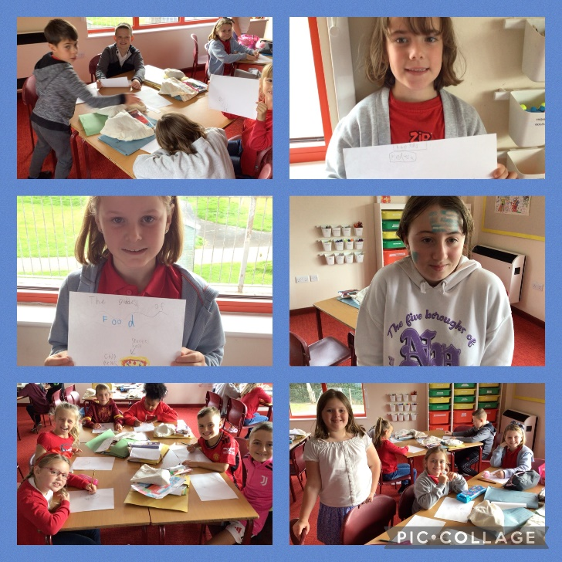
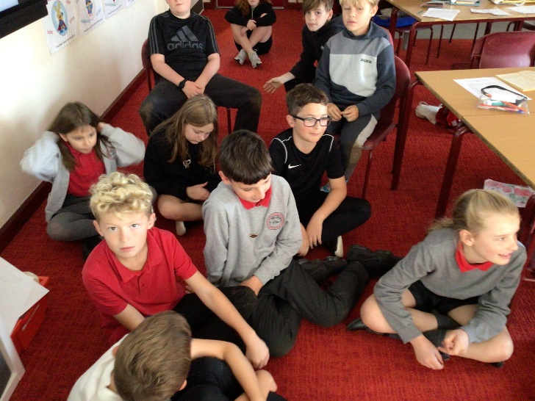
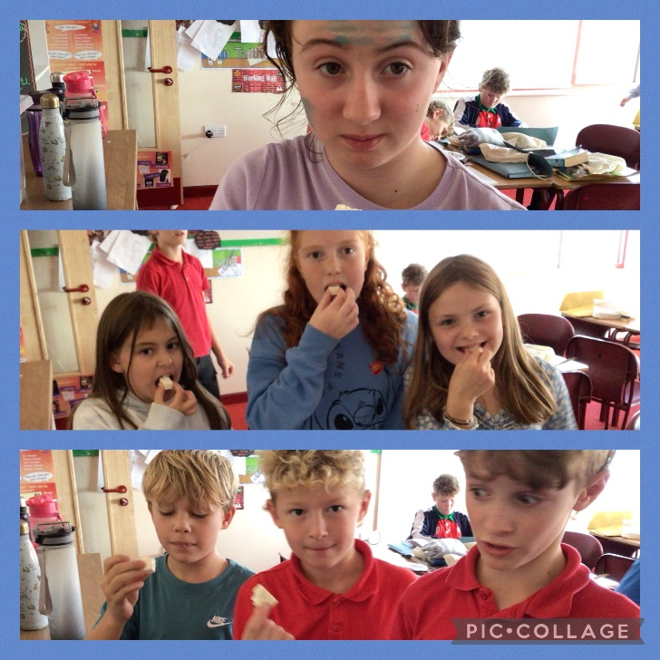
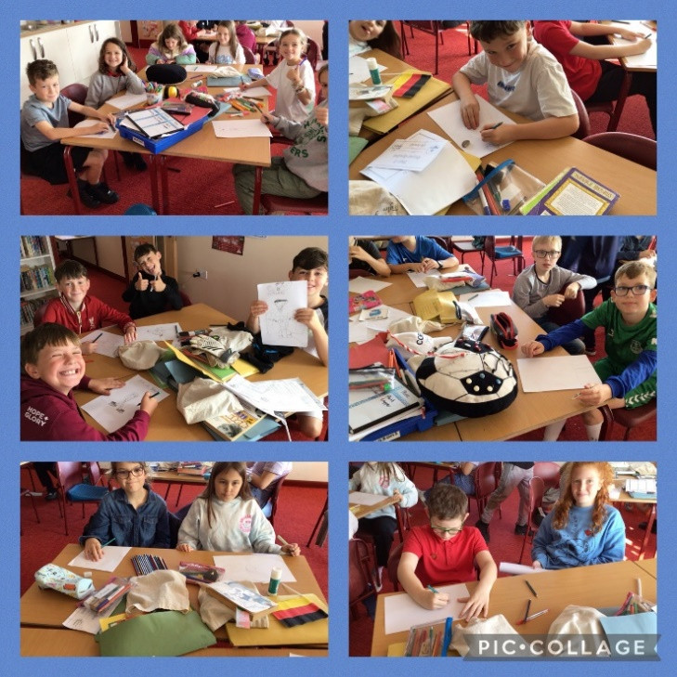
Our week in pictures …

Slide 6
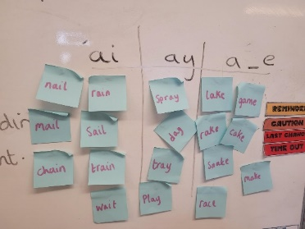
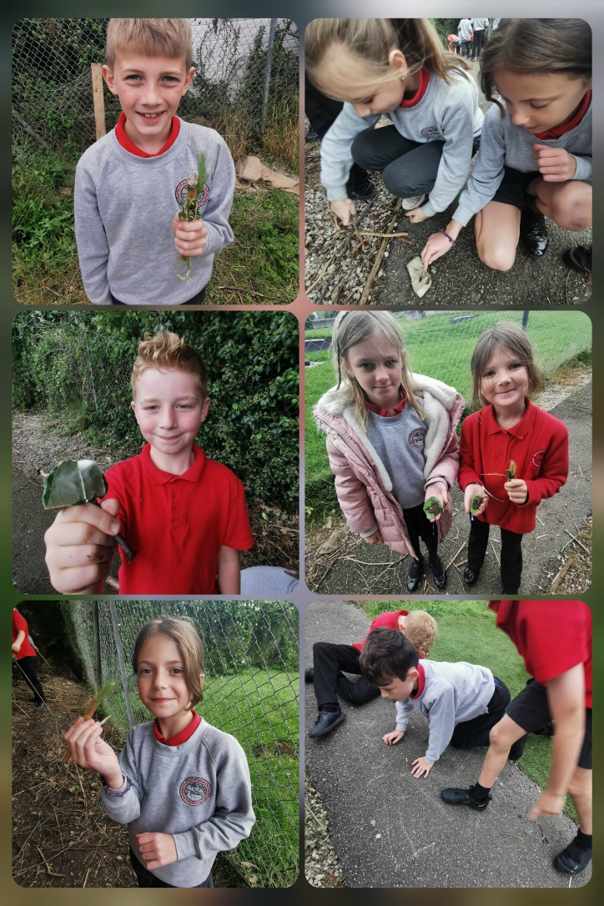
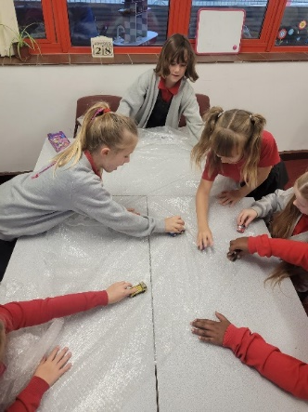
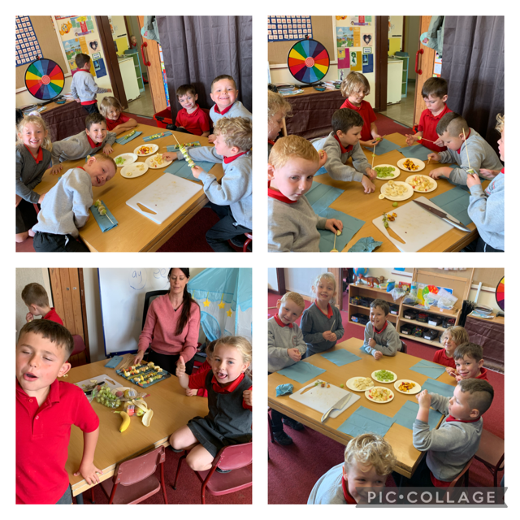
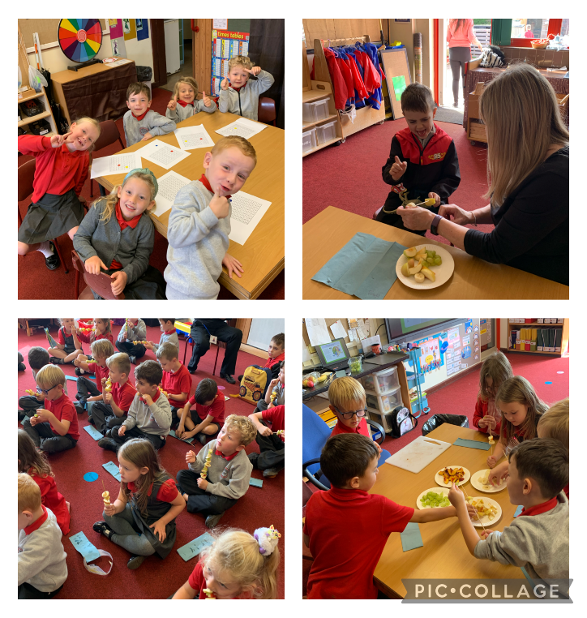
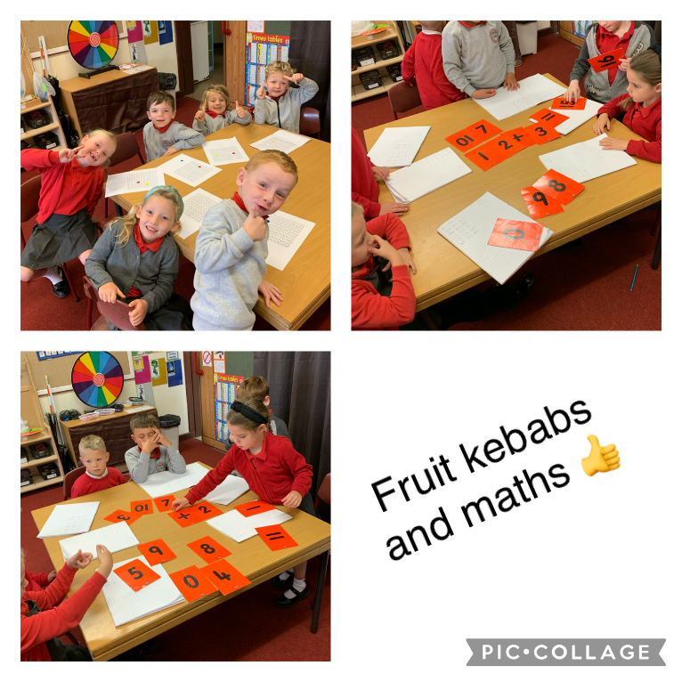
Our week in pictures …

